Slide 1
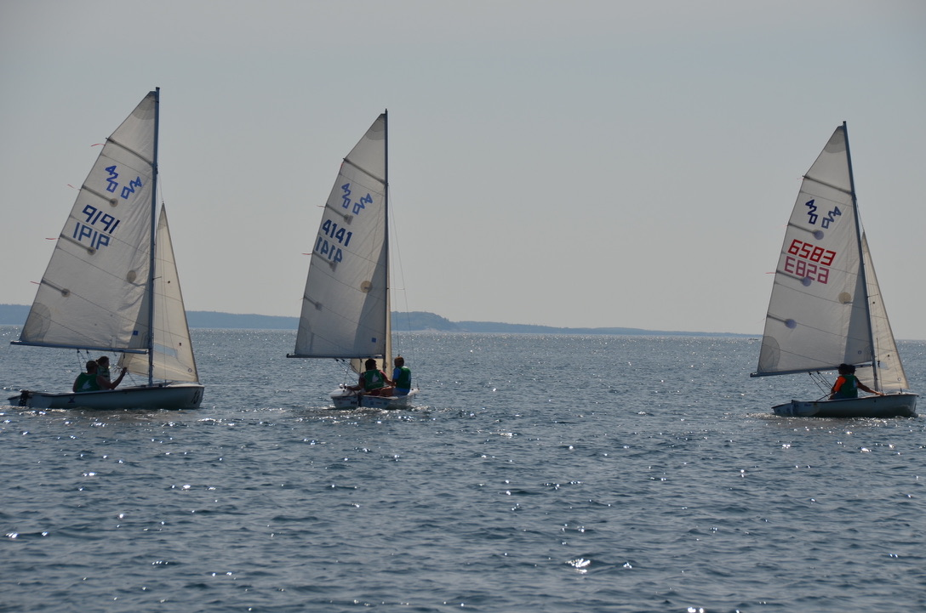
2025 HSC Race Team Program Handbook
Sailor & Parent Guide Hubbards Sailing Club

Slide 2
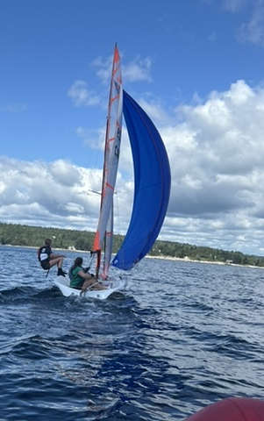
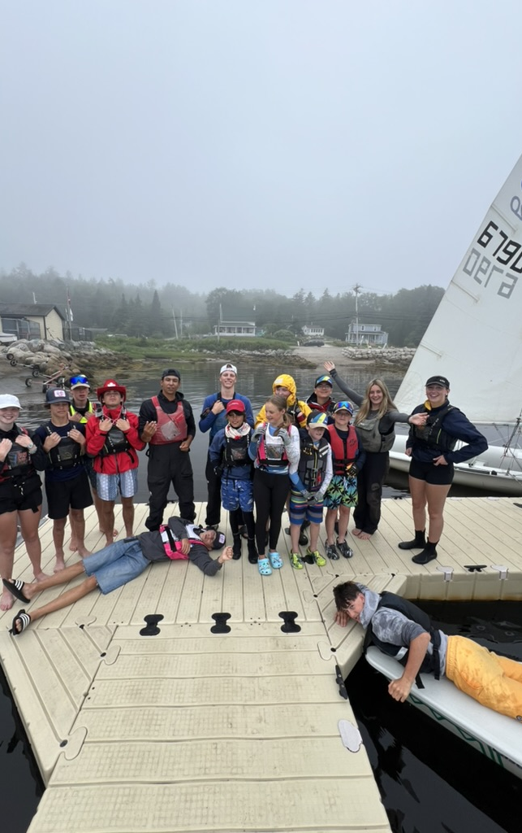
WELCOME to the 2025 Race Team
This year we have put together a short information package before the season starts. The aim of this guide is to outline the roles and responsibilities of team members and their parents and provide essential facts about racing with HSC. We hope you find the following pages useful and look forward to seeing you all this summer!

Slide 3
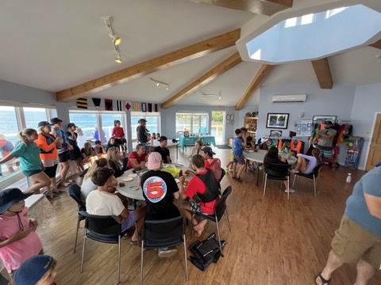
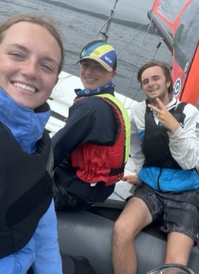
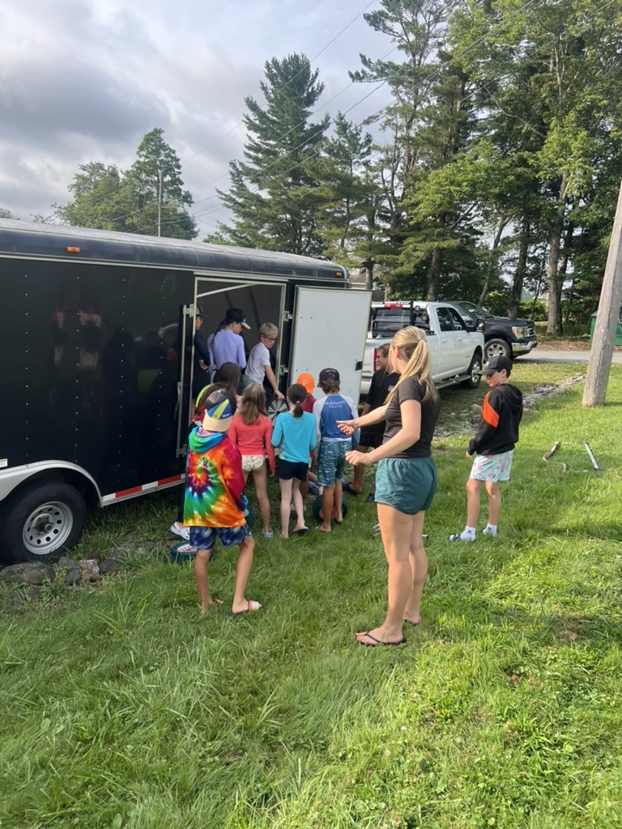
Contents
- Getting Started / Contacts - Notable Dates - Registering for Regattas - Cost Sharing - Responsibilities (Sailor, Coach, Parent) - Towing to Regattas - Gear & Packing - Regatta Checklist - Weather & Terms

Slide 4
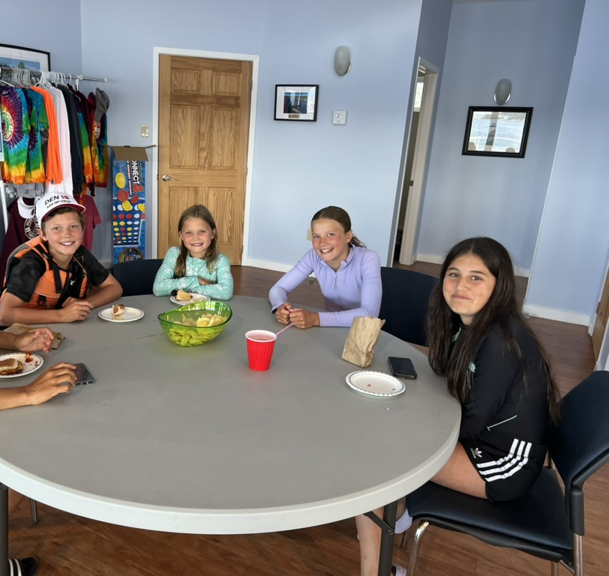
Getting Started
The HSC Race Team spends most of the summer training from our home base at the Hubbards Sailing Club.
Although no two training days are ever the same, we do have a similar format that we tend to follow. Drop off is at 9am.
Typically, sailors will arrive, rig, do fitness and a land lesson/brief, then we get dressed for the water, grab a quick and nutritious lunch before heading out on the water for our training session.
Finally, we come back in after training in time for the team to derig and debrief.
Pickup is 4pm. The best way to improve your sailing is to keep sailing. When the weather works with us, we tend to maximize our sailing time and make the most of our training days.

Slide 5
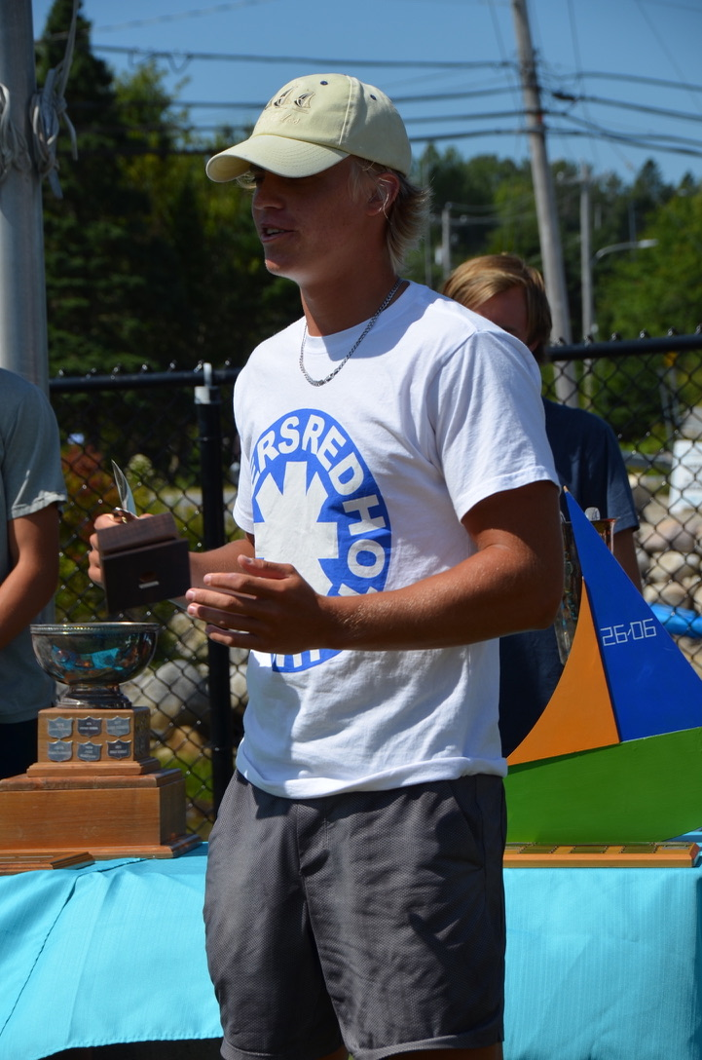
Name | Role | Contact
Karen Bell | General Manager | sailing@hubbardssailingclub.ca
Jenna Flemming | Head Coach | jlflemming13@icloud.com
Noah Villafane | 420 Race | noahvillafane@gmail.com
Josh Edwards | Laser Race | Ilcacoach.hsc@gmail.com
Owen Flemming | Opti Race | owen_f77@yahoo.com
Jessica Doane | Opti Intro to Race | jessica.doane@icloud.com
Anthony Bell | LTS Director | bellassociates@gmail.com

Slide 6
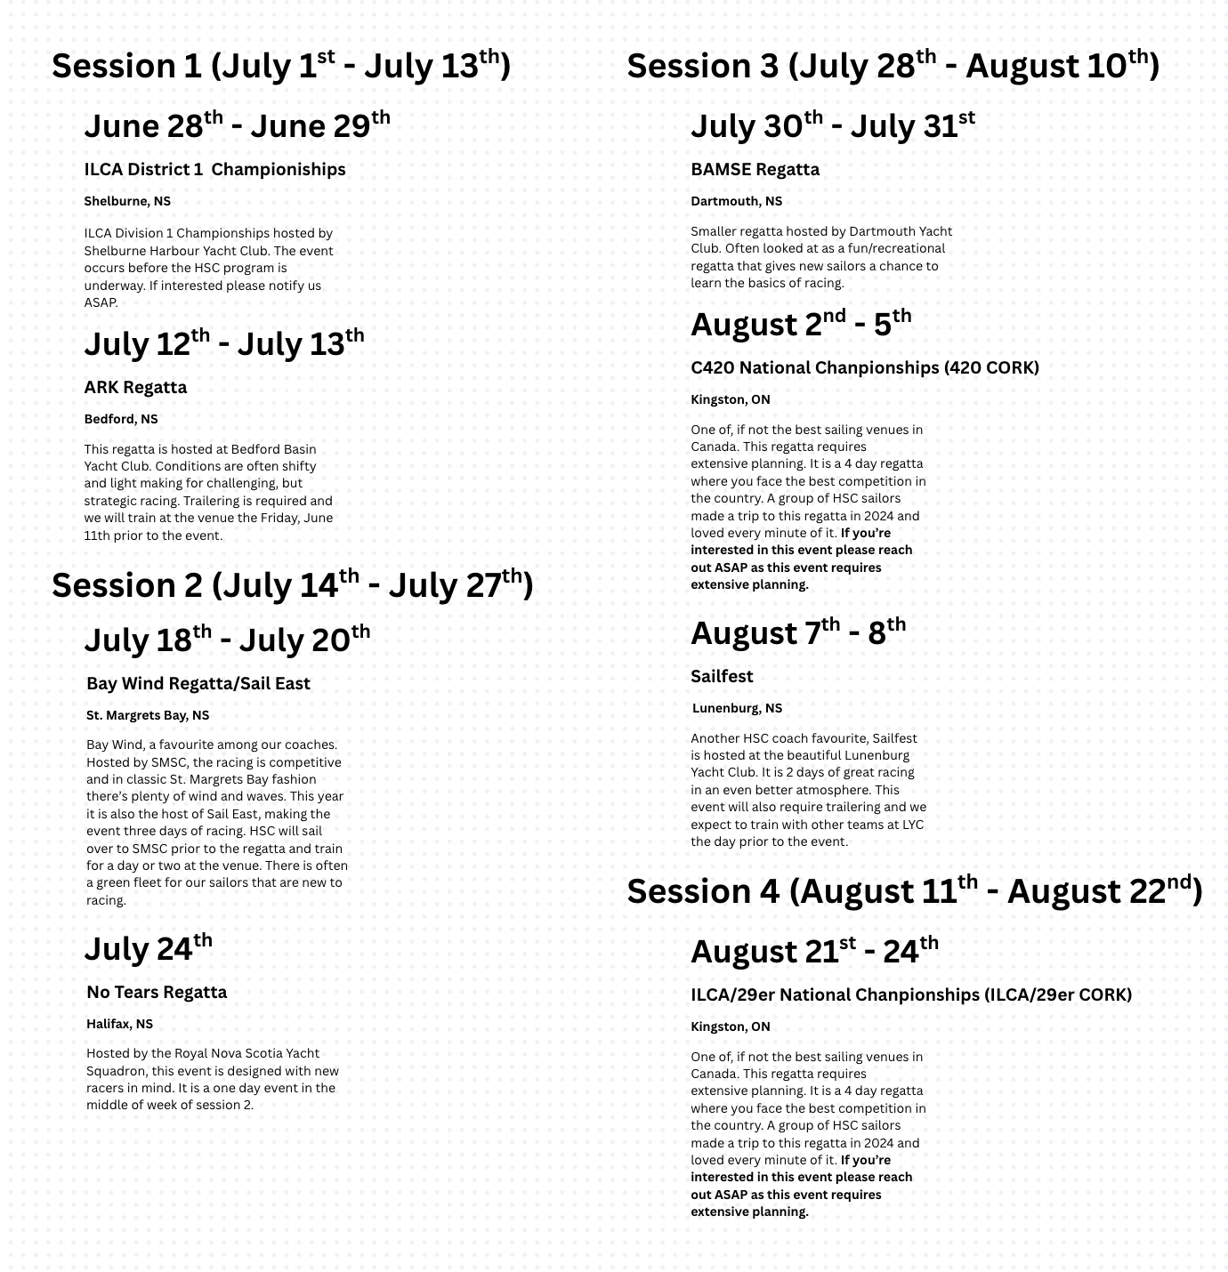
Notable Dates

Slide 7
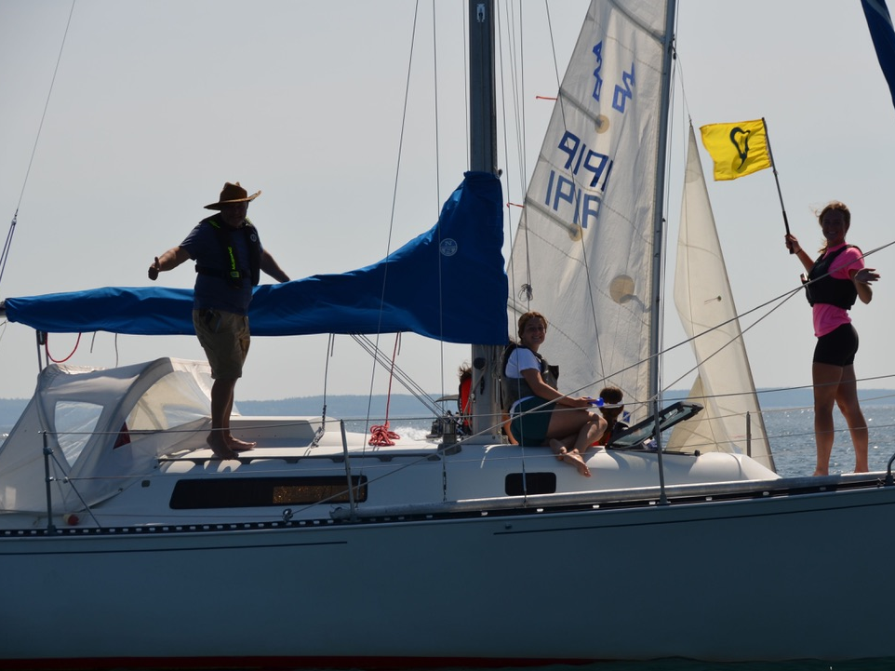
August 16th-22nd
Opti Nationals
RNSYS
August 26th and 27th
Opti Provincials
Hubbards Sailing Club!!!

Slide 8
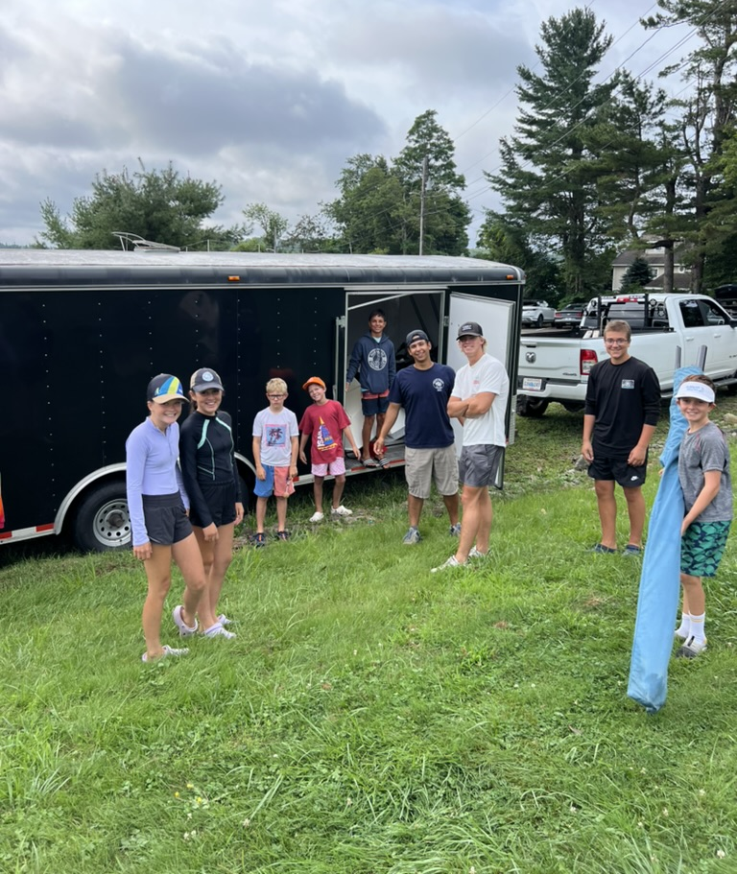
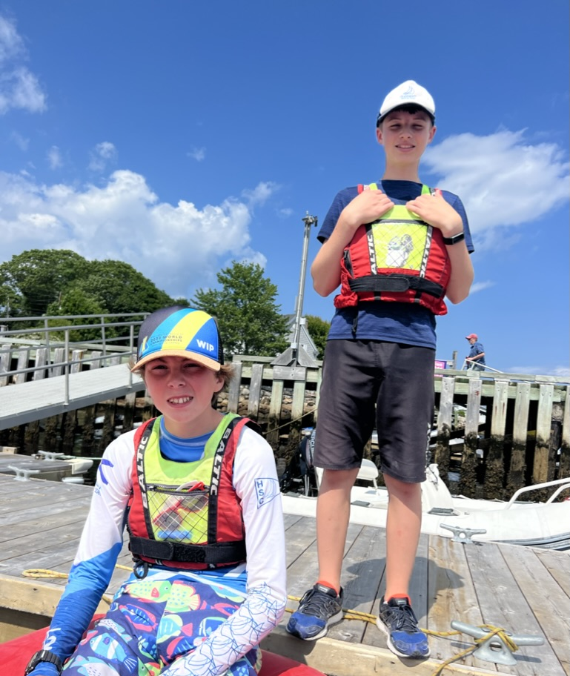
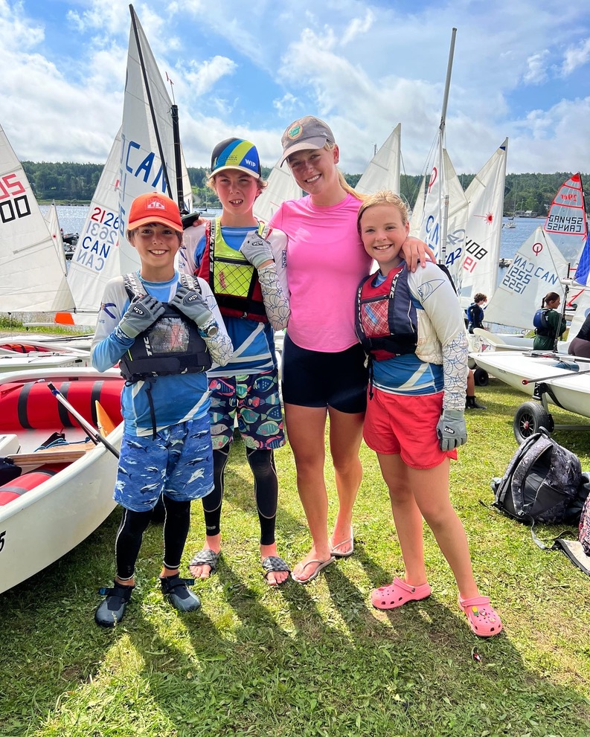
Regatta Registration
Each regatta has its own registration fee.
It is the responsibility of parents to sign their sailor up for each regatta that they plan to compete in. This can be done online, directly with the host yacht club. If you sign up by the early registration date, there is a discount. You can also print out the Notice of Race.
Please note that your sailor must be:
Junior Member of HSC, in good standing
Sail NS Member
Sail Canada Member ($40)* * You must register with Sail Canada personally to obtain your membership number. If you have forgotten your number, you can do a search for it at: https://members.sailing.ca/index.php?action=_login.find_cya_number

Slide 9
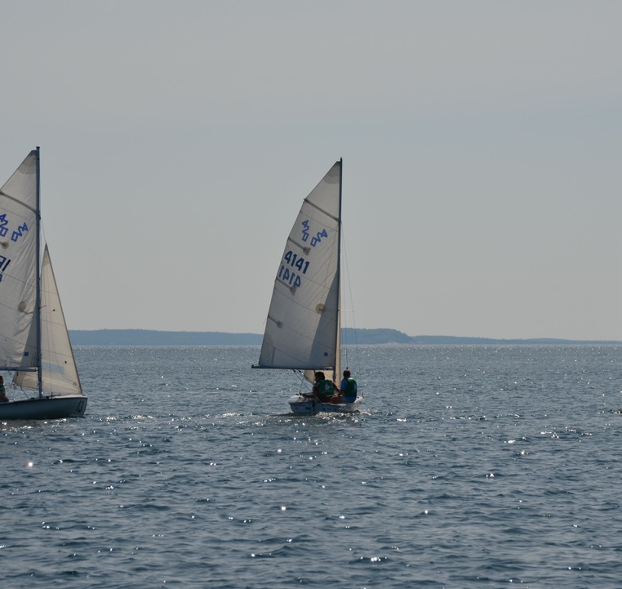
Cost Sharing
$90 fee coach fee per weekend regatta per sailor
$50 fee coach fee per in session week regatta per sailor - Covers coach wages, fuel, trailering - Trailer drivers get $20 discount/trip - Towing = Fee waived

Slide 10
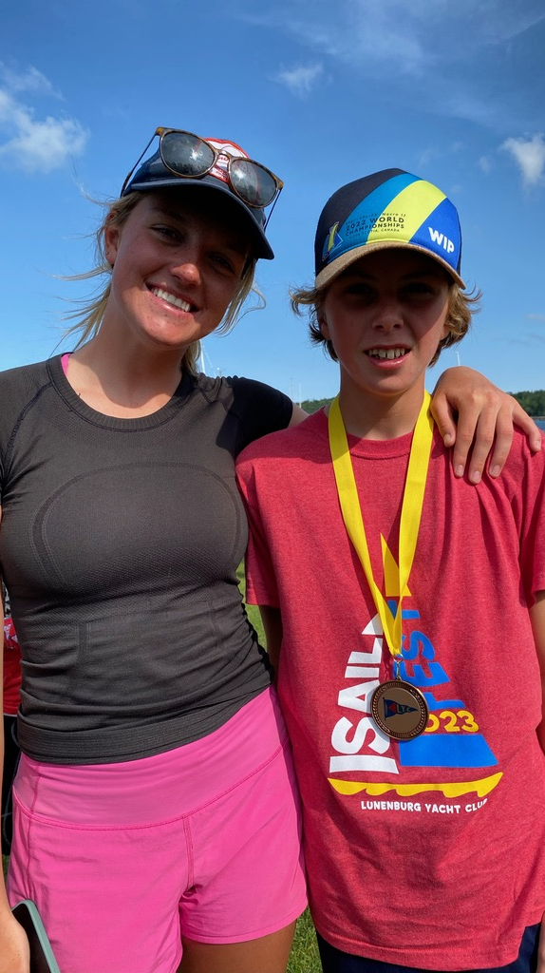
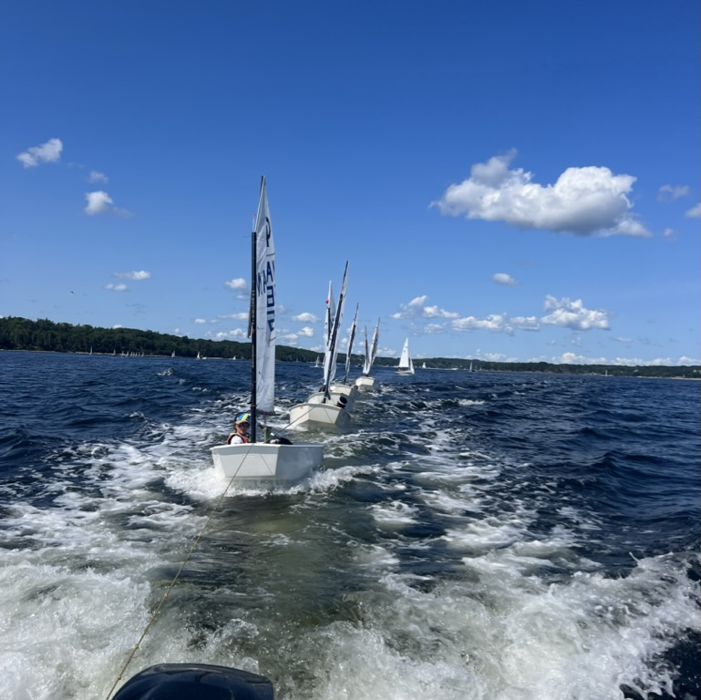
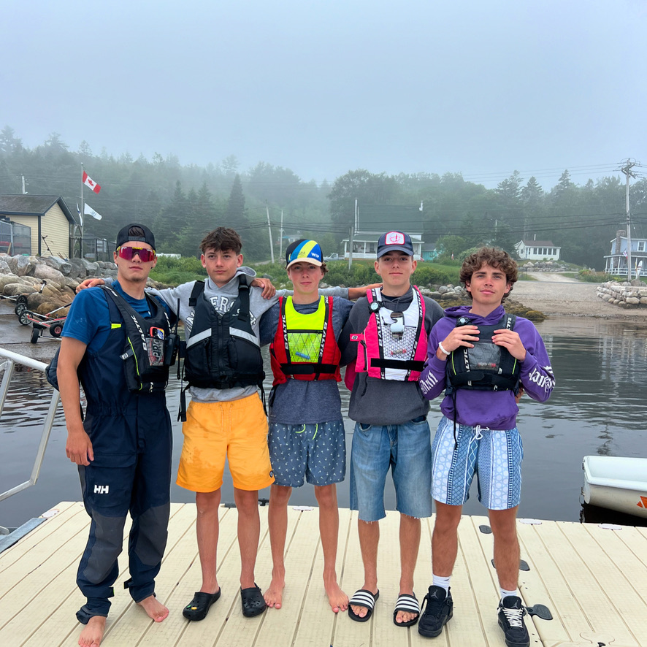
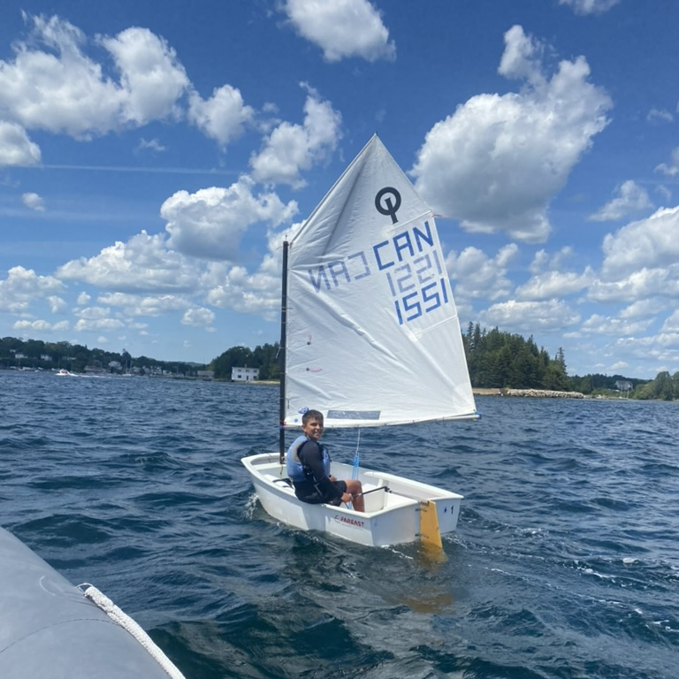
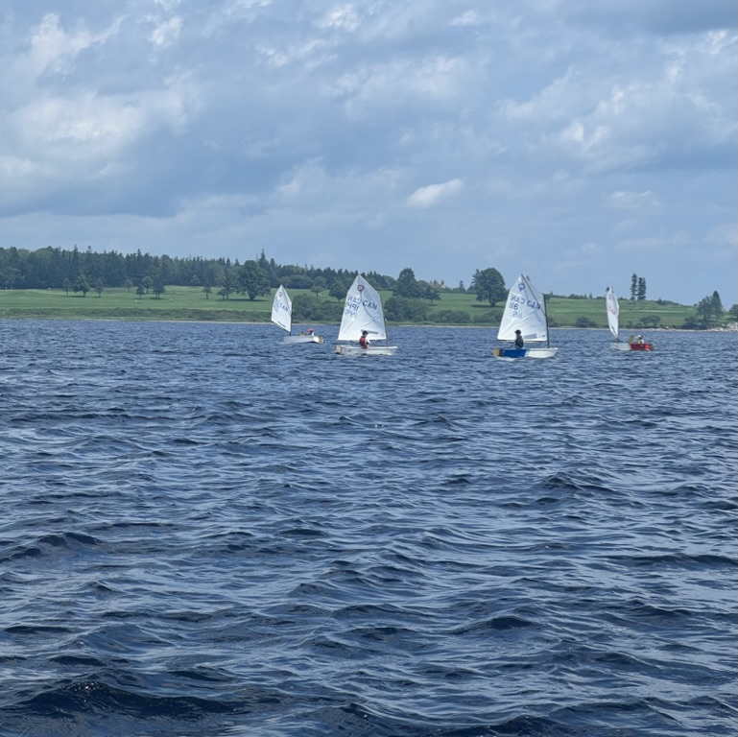
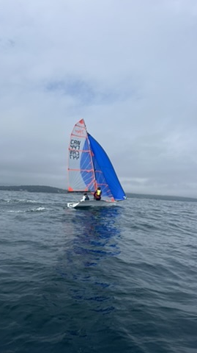
Sailor Responsibilities
Rig promptly when you arrive in the morning and de-rig as soon as possible when you get off the water. The quicker we can rig and de-rig as a team, the more time we can spend sailing.
Listen to your coach both on the water and on land. This is extremely important for safety, and it will ensure you get the most out of each day.
Help load and unload all boats, trailers and equipment as a TEAM when we go to regattas and when we return to the club.
Take care of the equipment assigned to you like it’s your own!
Come prepared to sail/train. Try your best each day. Bring your best effort.
Support one another.
Remember you are the HSC Race TEAM.
Have Fun!!!!!!!!!!!!!!!!!!!!!!!!

Slide 11
Coach Responsibilities
Ensure safety (weather, sun, etc.)
Supportive learning space
Communicate with parents
Oversee logistics
Hand over the sailors to their parents at the end of the lessons/regattas
Provide feedback to the parents and sailors as appropriate.
Oversee the safe loading and unloading of boats and trailers

Slide 12
Parent Responsibilities
Ensure that your child comes prepared for training and regattas  Help to unload and load trailers at regattas
Attend regatta planning meetings
Help all team members get their boats into and out of the water
Understand the logistics that are in place for transporting boats to and from each regatta; volunteer your time if you are able (see section on Towing to Regattas)
Be supportive
Conditions, abilities and energy level can change and vary throughout a regatta. Provide plenty of encouragement when they return to land

Slide 13
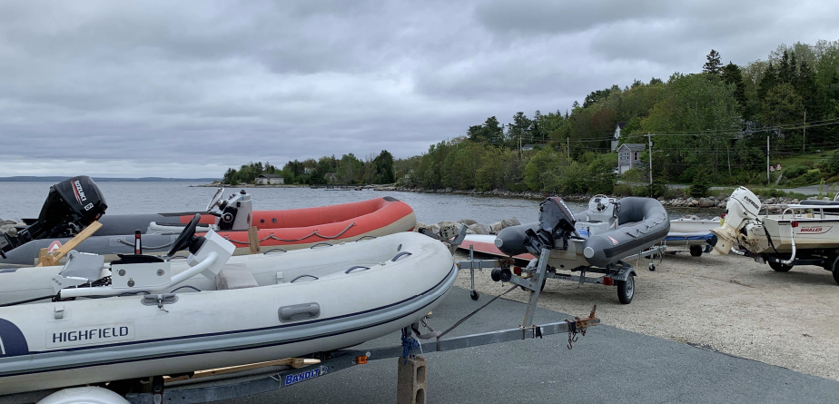
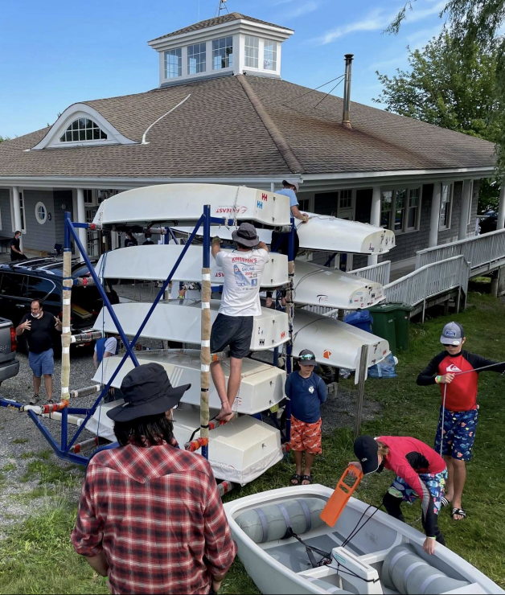
Towing to Regattas
In order for sailors to attend regattas, we need to have enough parents willing and able to tow trailers, to and from, each regatta. We have trailers that tow both sailboats and coach boats.
Once our regatta schedule and participation is confirmed, a towing schedule will be made. Parents who tow trailers are compensated. Please see Cost Sharing on page 8.
Sailors and coaches will load boats before a regatta. If you are the parent towing, please check that everything is tied securely.
Make sure the lights are operating correctly, that you have a copy of the insurance paperwork and that you have hooked up the trailer correctly.
If you are new to towing, we have many parents and coaches who can provide some guidance.

Slide 14
Packing Checklist – Daily
Every Day
ALL CONDITIONS
Lifejacket
Water bottle
Rash guard
Sunscreen
Hat and sunglasses
Sailing gloves
Sailing booties or water shoes (close-toed)
Waterproof watch with counting function
Hiking pants are recommended but are not essential
Warm up clothes – Sneakers and shorts or track pants
Notebook (Wet Notes) for lessons or debrief
Full change of clothes
COOL WEATHER (below 20 degrees C)
Shorty wetsuit and/or long wetsuit (Opti)
Spray top
Rain pants
Toque
WARM WEATHER (Above 20 degrees C)
A top layer to protect from the sun (full sleeve rash guards work well)
Bathing suit
*It is important to dress in layers. *It is usually 5 degrees cooler on the water than on land

Slide 15
Inclement Weather
We sail in most safe conditions
We monitor the conditions using a variety of technologies; the Weather Office, Wind Guru, Wind Finder, Lightning Radar, Our coaches goal is to prepare sailors to safely sail in all weather conditions.
Be prepared and dressed properly
Water = 5°C cooler than land

Slide 16
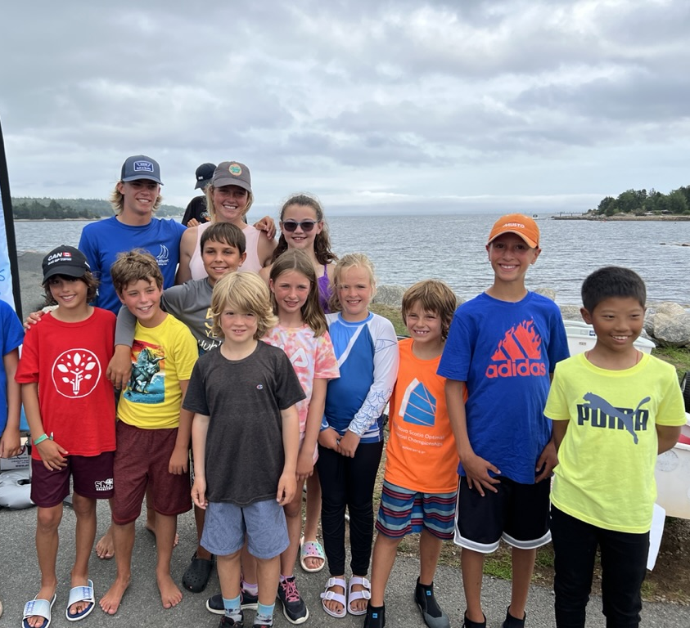
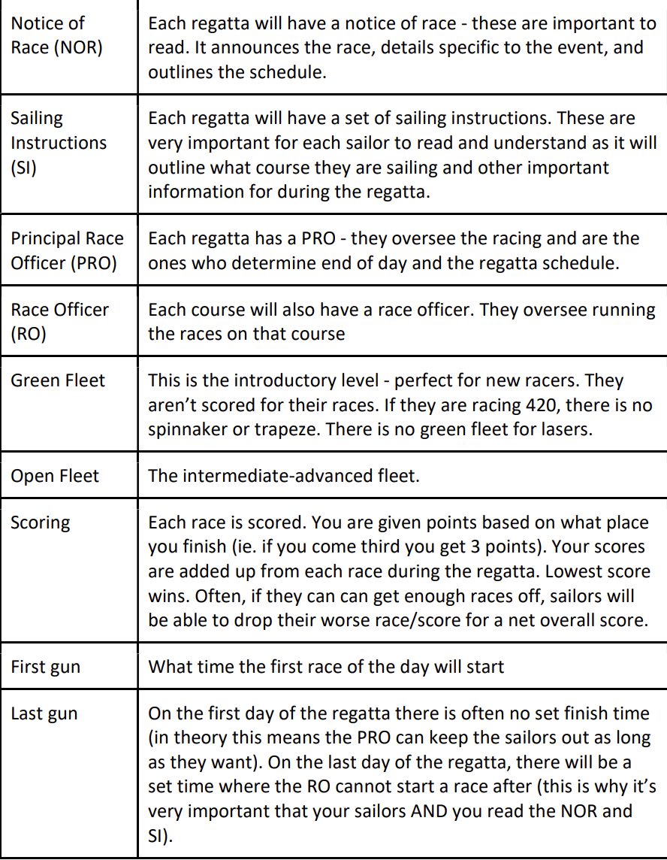
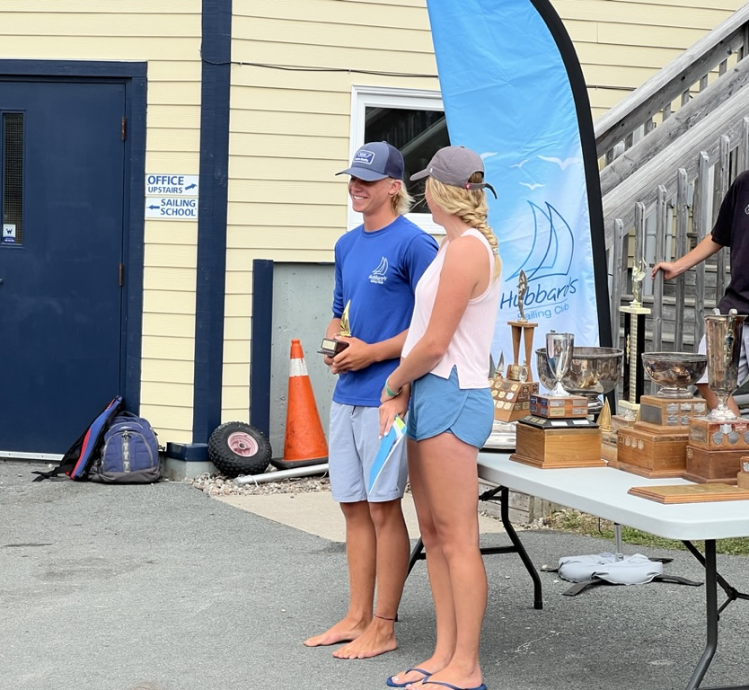
Helpful Terms

Slide 17
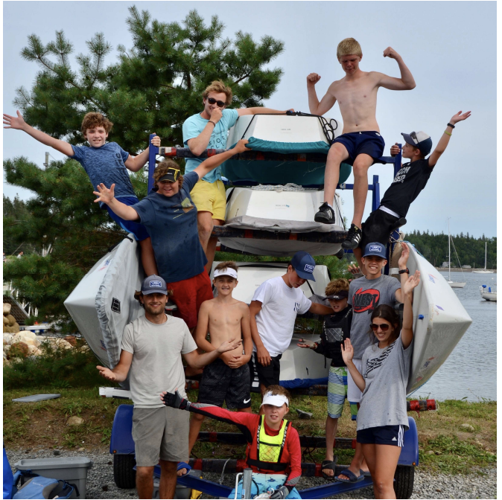
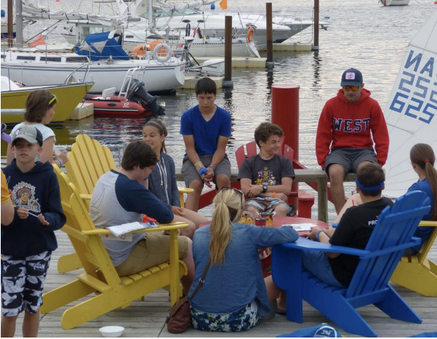
Contact Info
Hubbards Sailing Club PO Box 187, 215 Hwy 3, Hubbards, NS 902-857-9771 www.hubbardssailingclub.ca
sailing@hubbardssailingclub.ca
jlflemming13@icloud.com

